Slide 1
The Postdocs
Elena Labzina
Anna Klimovskaia
Agnieszka Noculak
Zurich, 3.11.2019

Slide 2
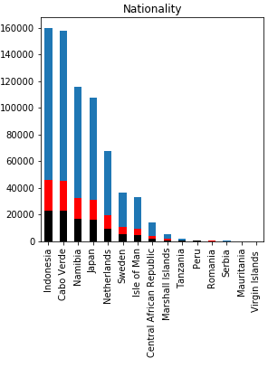
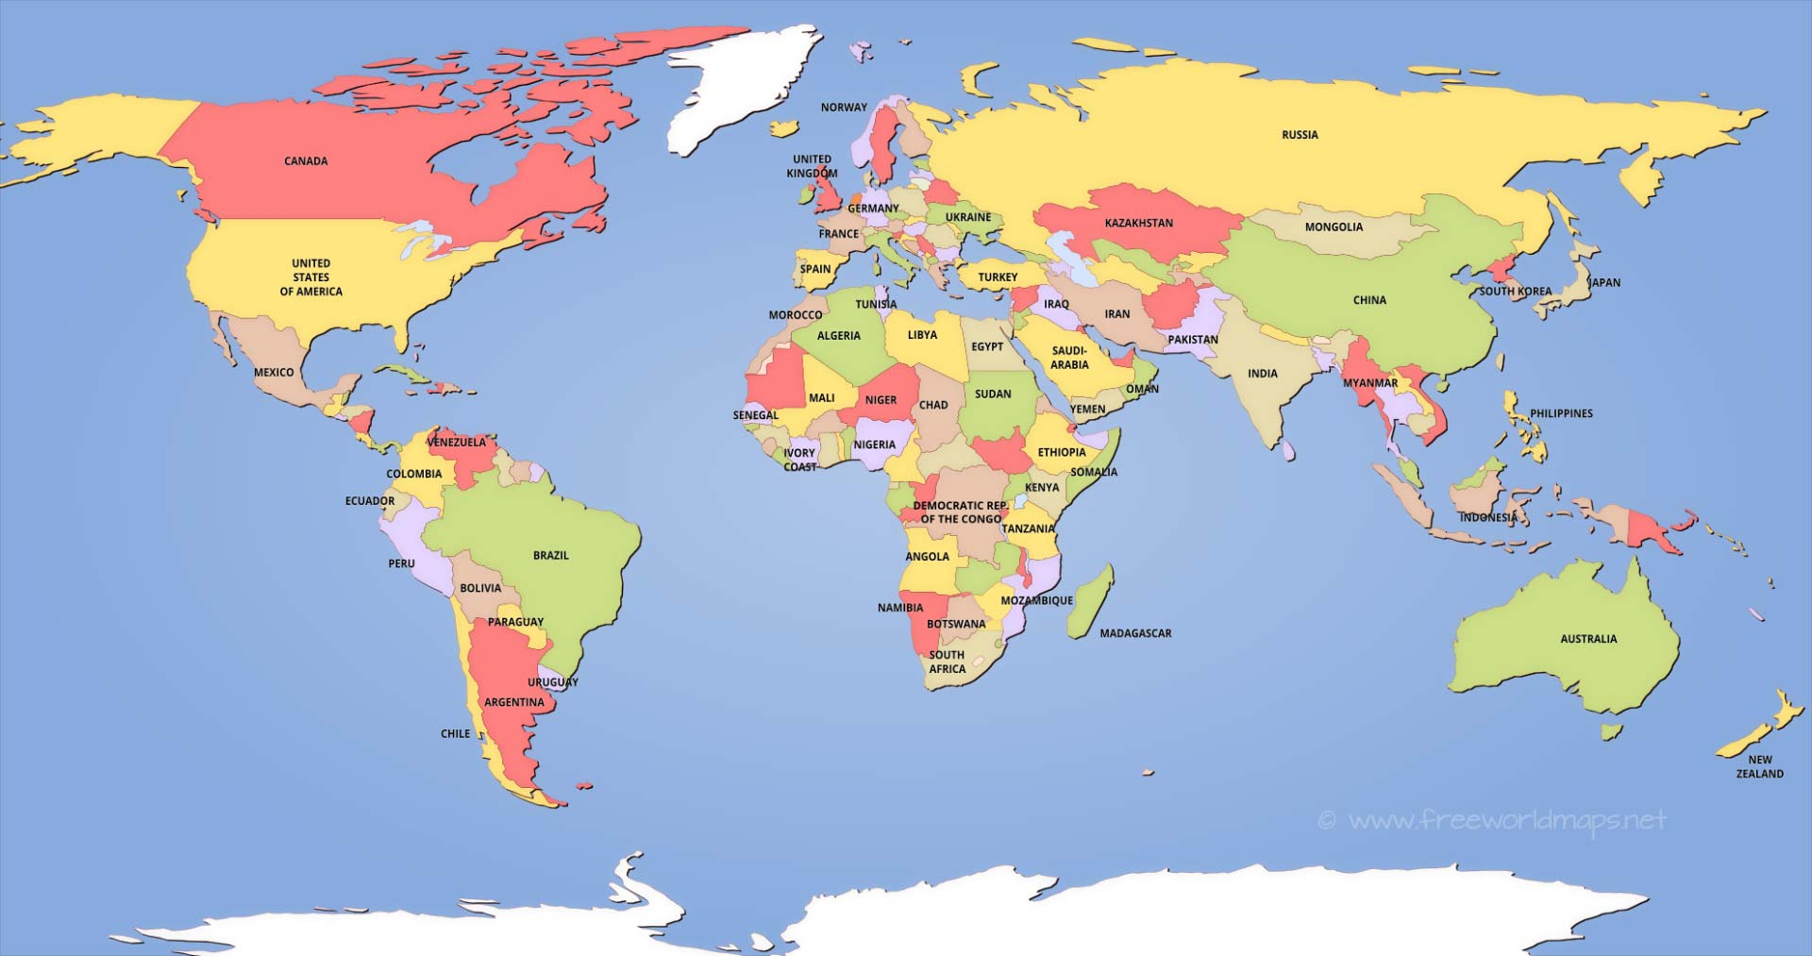
Not representative dataset!!!
Individual
Company
Other
16 (big dataset), 11 (small dataset)
Credit Suisse is active in 26 countries across the Europe, Middle East and Africa

Slide 3
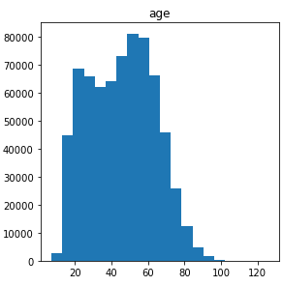
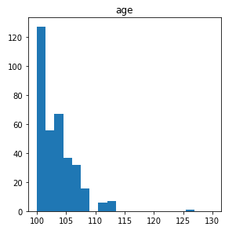
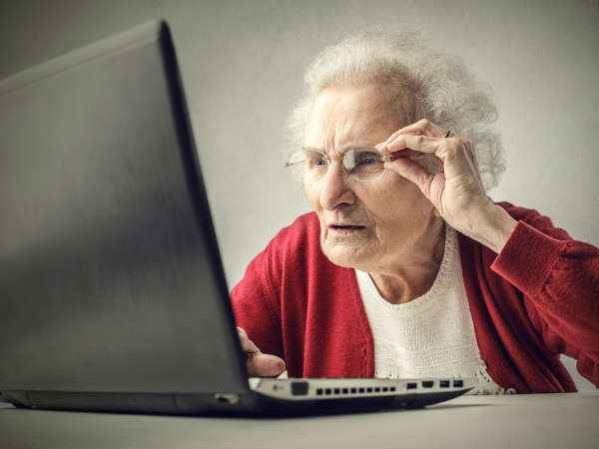
Not enought amount of the data
Is there any other person who has access to the account (parent in case of young age, child in case of older person)??

Slide 4
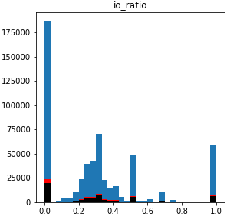
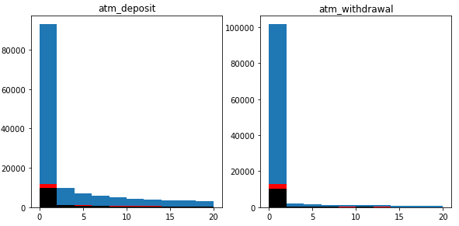
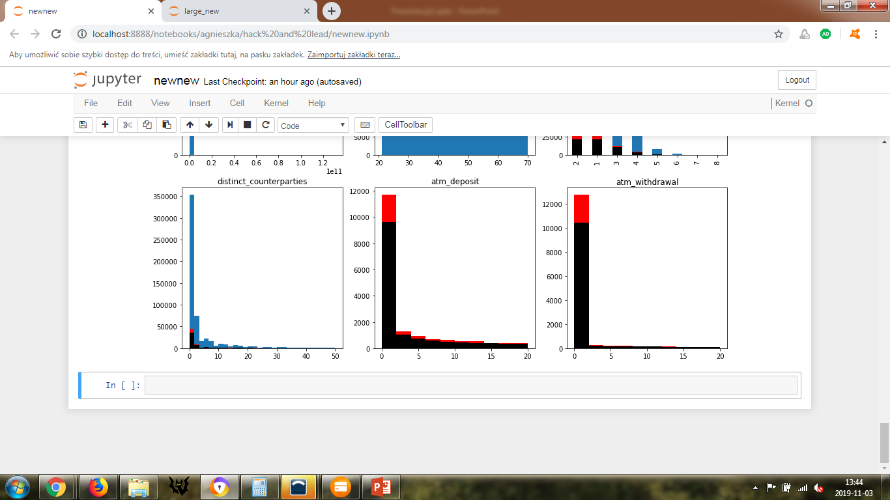
Assuming that only one person has access to the account:
We should look check if the old clients are really alive and can make all those operations
We can check youg people with high inflow (io_ratio), young/older people with high atm deposit.
Ad.1
Adult
Young (<20)
Older (>70)

Slide 5
Missed data which can be useful
Name of the country/city where transactions with ATM take place
Name of the destination places of money transfer (terrorism, war)
Mobile data (locations and movements)
Date of the money tranfer (elections, conflicts, natural disasters)
Some people have more than 1 account, it would be nice to know what kind of account is it
Social networks

Slide 6
Unsupervised learning
1st Data (w/o Fraud marking)
Removing Outliers
Histograms, records in bin < 10
Remained data
Outliers
Louvain algorithm
Clustering
Visulalization
Umap

Slide 7
Unsupervised learning + Labels
1st Data + 2nd Data
Data balancing
undersampling
Clustering
Louvain algorithm
Statistics
Mean values
What is the amount of frauds in each cluster?

Slide 8

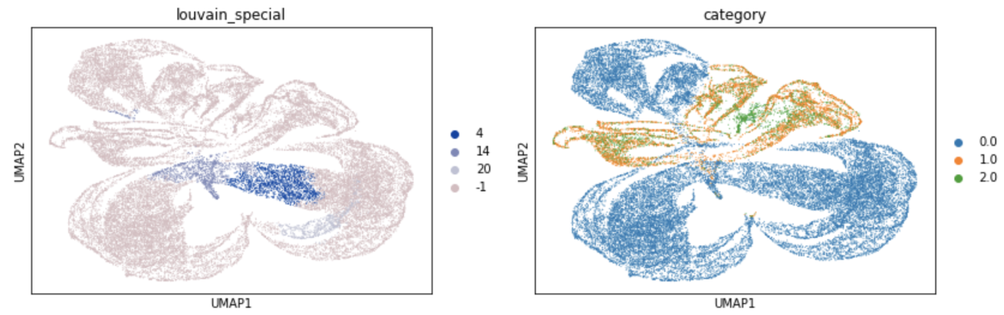
Individual acts as a company
Lots of Individuals who were matched as suspicious acts as company
Train a classifier based on some features to predict if this is a human.
If the human predicted to be a company then it’s a potential fraud.

Slide 9
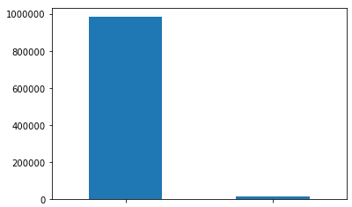
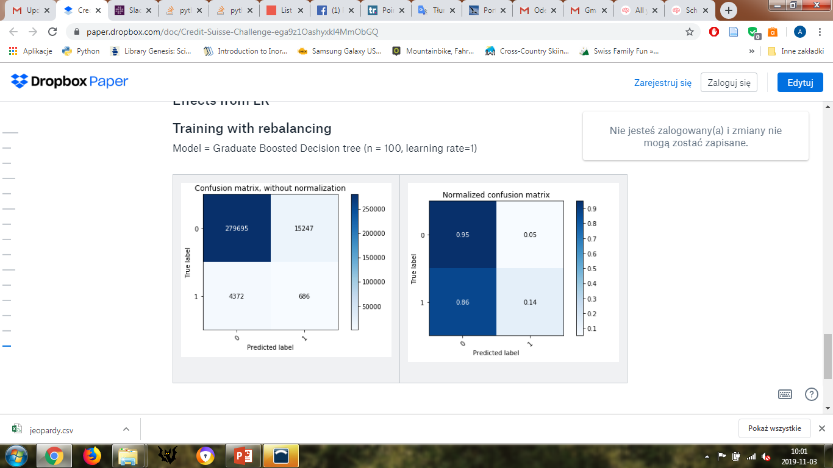
Supervised learning w/o balancing
Why proper data balancing is so important?
LR: 0.982739 (0.000563)
LDA: 0.978820 (0.000726)
KNN: 0.982577 (0.000564)
CART: 0.969629 (0.000609)
RFC: 0.984486 (0.000431)
NB: 0.980204 (0.001145)
Only 1.71 % of all data constitutes suspisious cases
Not suspicious
Suspicious
Training w/o rebalancing causes that model will assign almost all of the records as to not suspicious class

Slide 10
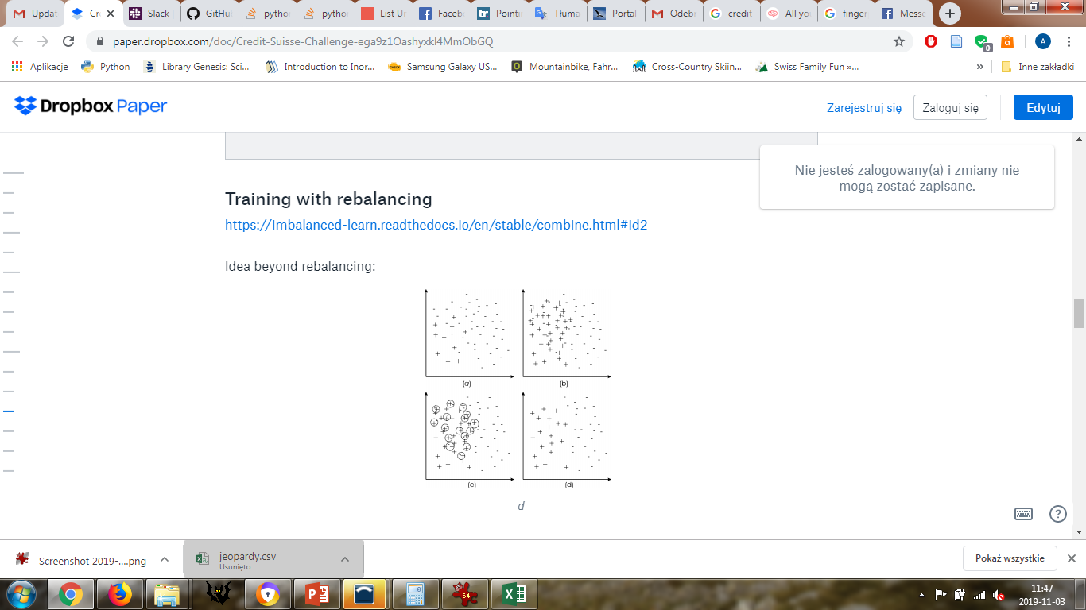
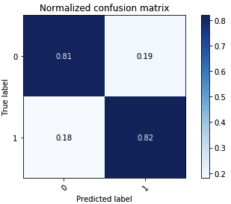
Supervised learning with balancing
Data balancing: SMOTE + Tomek
Model: Logistic regression

Slide 11
Supervised learning with balancing
Identifying the most influential features
Permutation feature scores for the features : LR and Boosted Decision Trees

Slide 12
Supervised learning with balancing: Direction of the effect (based on LR)
Turnover decreases the likelihood of fraud
ATM deposit increases the likelihood of fraud
IO ratio increases the likelihood of fraud
Age increases the likelihood of fraud

Slide 13

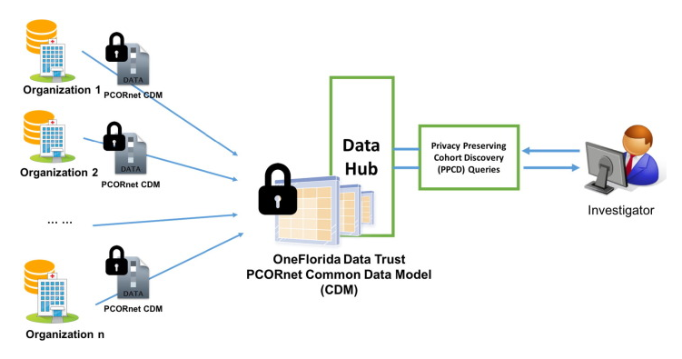
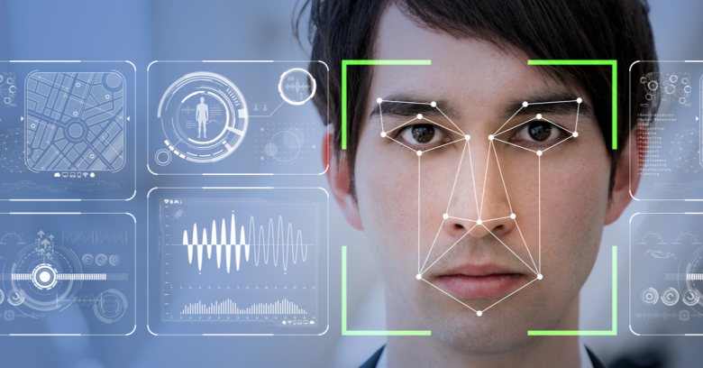
Money laundry detection in the future
Yes, I’ve just transfered 20000 CHF to Afganistan ☺
More international legal control on bitcoins’ operations
Distributed Privacy Preserving Information sharing
ATM face/fingerprint detection
Improve detection algorithms:
Deep Reinforcement Learning
Advanced balancing algorithms

Slide 14
Thank you for your attention!

